Slide 1
Memory Hierarchy
CSE-3109 Computer Architecture Lecture 9

Slide 2
Memory Hierarchy
A memory hierarchy consists of multiple levels of memory with different speeds and sizes.
The faster memories are more expensive per bit than the slower memories and thus smaller.
Three technologies used in building memory hierarchies:
1. DRAM (Main memory)
2. SRAM (Cache)
3. Magnetic disk (Hard disk)

Slide 3
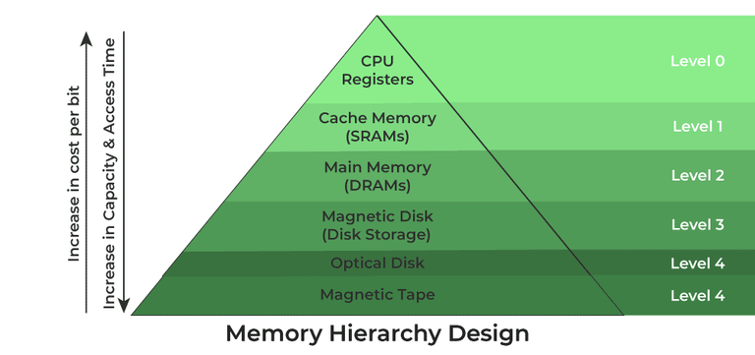
Memory Hierarchy

Slide 4
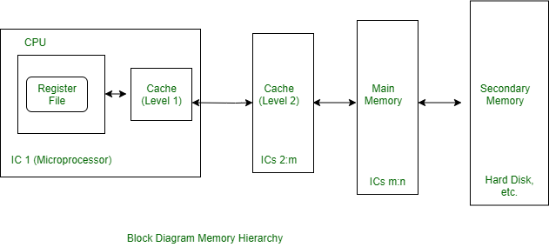
Memory Hierarchy
A computer system's memory structure manages variations in speed.

Slide 5

Memory Hierarchy
The goal is to provide the user with as much memory as is available in the cheapest technology, while providing access at the speed offered by the fastest memory.

Slide 6
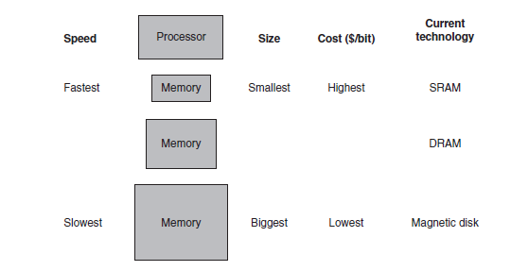
Memory Hierarchy

Slide 7
Data Hierarchy
The data is similarly hierarchical: a level closer to the processor is generally a subset of any level further away, and all the data is stored at the lowest level.
A memory hierarchy can consist of multiple levels, but data is copied between only two adjacent levels at a time, so we can focus our attention on just two levels. The upper level—the one closer to the processor—is smaller and faster than the lower level, since the upper level uses technology that is more expensive.
Within each level, the unit of information that is present or not is called a block or a line. Usually we transfer an entire block when we copy something between levels.

Slide 8
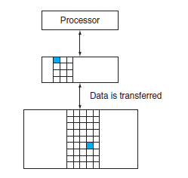
Data Hierarchy

Slide 9
Hit and Miss
If the data requested by the processor appears in some block in the upper level, this is called a hit
If the data is not found in the upper level, the request is called a miss. The lower level in the hierarchy is then accessed to retrieve the block containing the requested data.
The hit rate, or hit ratio, is the fraction of memory accesses found in the upper level; it is often used as a measure of the performance of the memory hierarchy.
The miss rate (1 - hit rate) is the fraction of memory accesses not found in the upper level.

Slide 10
Hit time and Miss Penalty
Hit time is the time to access the upper level of the memory hierarchy, which includes the time needed to determine whether the access is a hit or a miss.
The miss penalty is the time to replace a block in the upper level with the corresponding block from the lower level, plus the time to deliver this block to the processor.
Because the upper level is smaller and built using faster memory parts, the hit time will be much smaller than the time to access the next level in the hierarchy, which is the major component of the miss penalty.

Slide 11
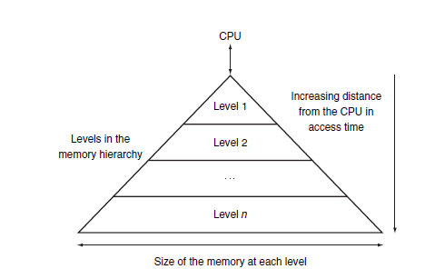
Continue
memory hierarchy uses smaller and faster memory technologies close to the processor.
Thus, accesses that hit in the highest level of the hierarchy can be processed quickly.
Accesses that miss go to lower levels of the hierarchy, which are larger but slower.

Slide 12
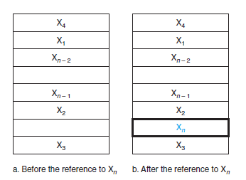
Cache
It refers to the level of memory hierarchy between the processor and main memory.
shows such a simple cache, before and after requesting a data item that is not initially in the cache. Before the request, the cache contains a collection of recent references X₁, X₂, . . . , X_{n - 1}, and the processor requests a word X_{n} that is not in the cache. This request results in a miss, and the word X_{n} is brought from memory into the cache.

Slide 13
Direct Mapped cache
How do we know if a data item is in the cache?
Moreover, if it is, how do we find it?
A cache structure in which each memory location is mapped to exactly one location in the cache is called direct mapped cache.
Almost all direct-mapped caches use this mapping to find a block:
(Block address) modulo (Number of blocks in the cache)
Notes:
In a direct-mapped cache each addressed location in main memory maps to a single location in cache memory. Since main memory is much larger than cache memory, there are many addresses in main memory that map to the same single location in cache memory.
In the direct mapping scheme, we map each block of main memory to only one specific cache location.

Slide 14
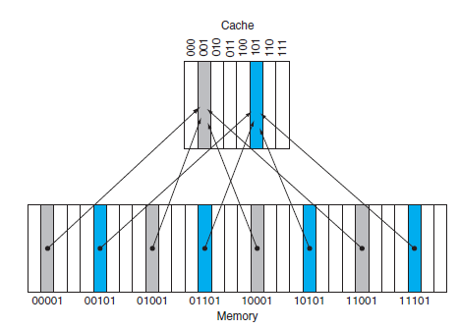
Continue
(Block address) modulo (Number of blocks in the cache)
If the number of entries in the cache is a power of 2, then modulo can be computed simply by using the low-order log₂ (cache size in blocks) bits of the address.
Thus, an 8-block cache uses the three lowest bits (8 = 2³) of the block address.

Slide 15
Tag
How do we know if a data item is in the cache?
We answer this question by adding a set of tags to the cache.
The tags Contain the address information required to identify whether a word in the cache corresponds to the requested word.
The tag needs only to contain the upper portion of the address, corresponding to the bits that are not used as an index into the cache.
In figure we need only the upper 2 of the 5 address bits in the tag, since the lower 3-bit index field of the address selects the block.

